Slide 1
Student Government Association 2018-19
Wesleyan College

Slide 2
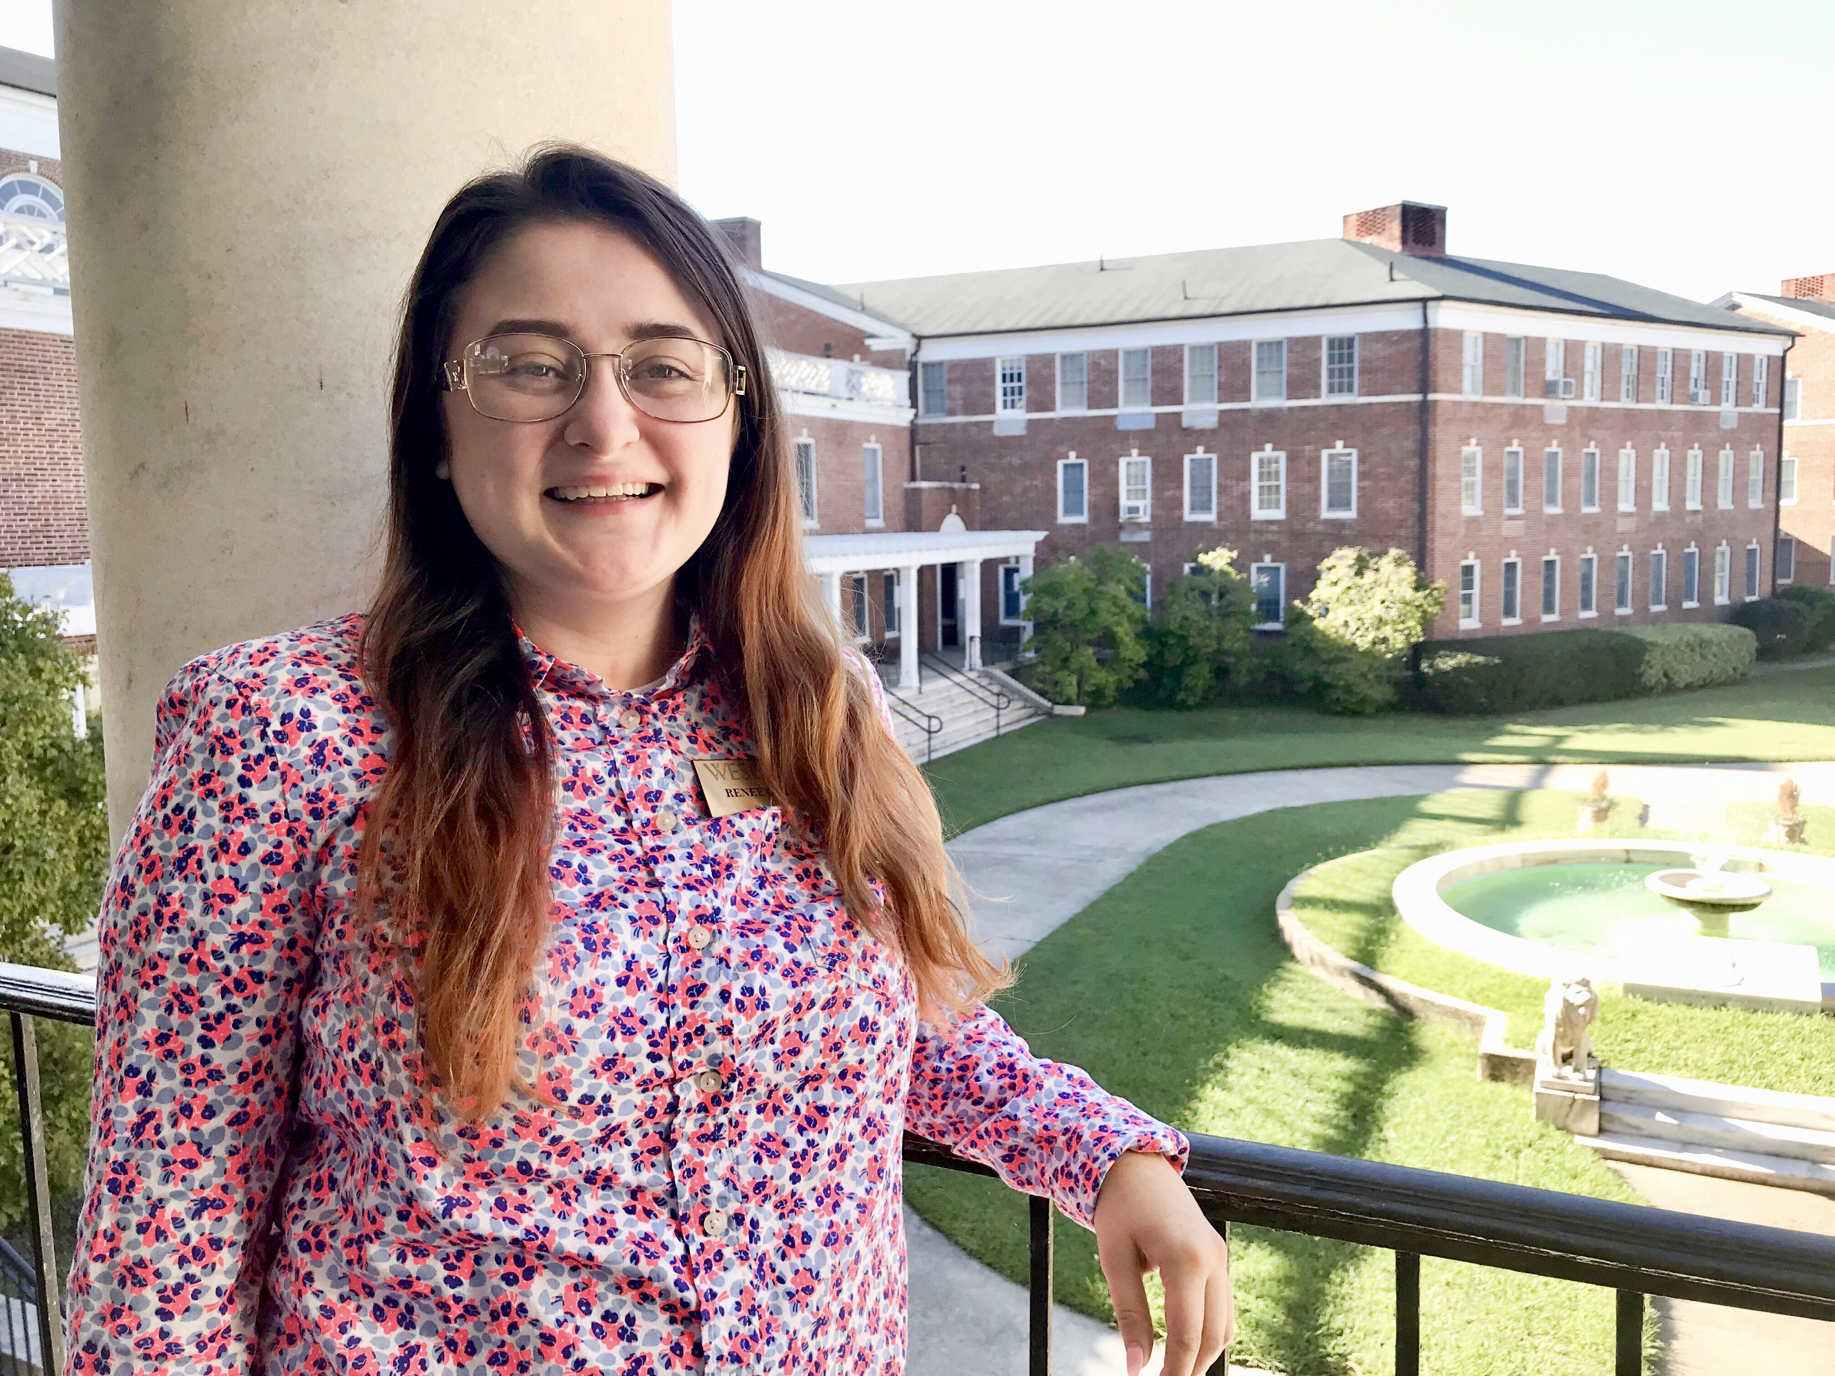
Renee Gable ’20
I am an junior majoring in early education with a minor in reading and religious studies. I am President of SGA, President of DANCE, and the Wesleyan Disciples Coordinator. I currently work in the education department, I am a tutor, an education major ambassador, and I am a support staff for a Wesleyan Employee who has a disability.

Slide 3
Restructuring Phase
SGA is currently undergoing internal reconstruction in an effort to make SGA a more effective organization to serve students.
We have formed three committees that will work in chronological order until March.
There was around 70% interest in team leadership in SGA.

Slide 4
Touring Committee
Led by Kearsetyn Bargeron ’22 and Grace Smith ’22
Tasked with observing the SGA meetings at colleges in the surrounding area. They will take notes of things that they like, and believe would work here at Wesleyan College.
After visiting multiple colleges, they will be reporting back to the Senate the things that they have observed.

Slide 5
Visionary Committee
Led by Fetty Blitch ’21
Tasked with envisioning a new structure for our SGA that would be more effective, and motivational for student leadership within SGA specifically.
They are going to be analyzing what structures we currently have in SGA that would continue to help us be successful, and incorporating new ideas into our structures.
They will be presenting this at a Senate meeting.

Slide 6
Formal Editing Committee
Led by Gillian Pritchett ’20
Tasked with writing proposed edits to our constitution and by-laws based on the ideas that the visionary committee has proposed.
They will present this to the Senate who will then vote on the proposed edits.

Slide 7
Continuing to Serve Students
SGA will continue to serve the study body through approving clubs, and assisting students with resolving their student concerns.
Elected senators will continue to be available to assist students in finding the resources they need to resolve student concerns.

Slide 8
SGA Senators
Kearsetyn Bargeron - Class of 2022
Saloni Ray- Class of 2022
Fetty Blitch - Class of 2021
Allison Strout - Class of 2021
Gillian Pritchett- Class of 2020
Jasmine Sims - Class of 2019

